Slide 1
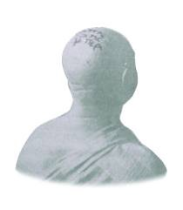
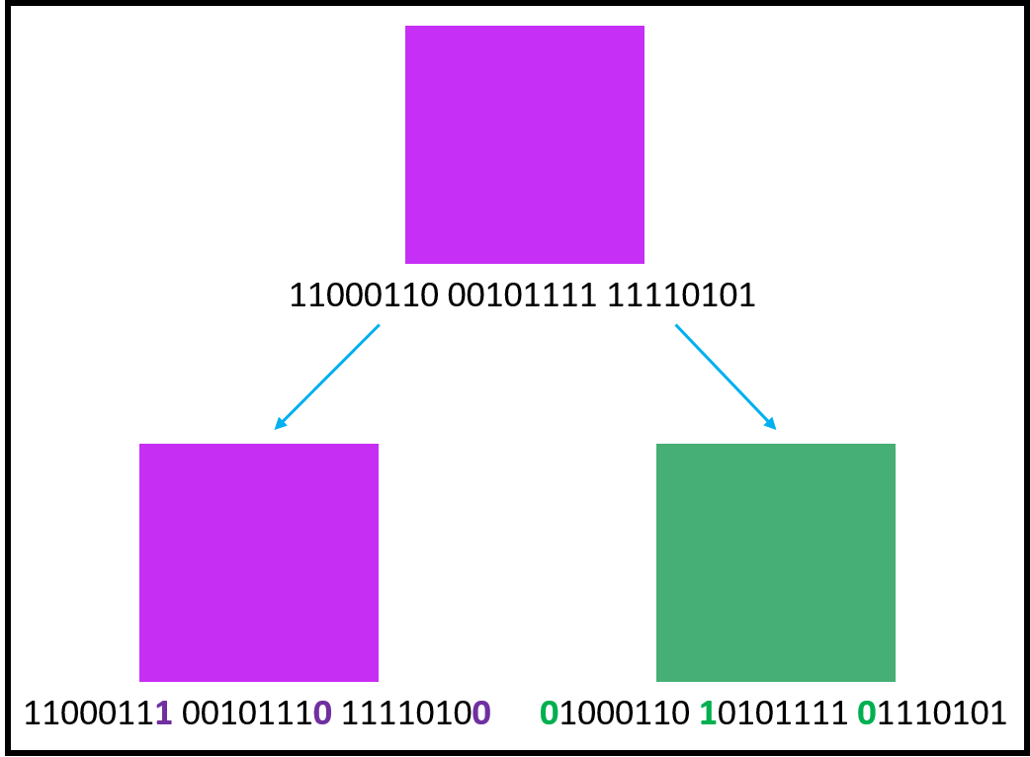

What is steganography, and how can I use it to conceal a message in a digital image and then retrieve it?
Definition
History
Modern Applications
Digital Images
+ Python program

Slide 2
The Research Process
Create a plan
Begin the research by collecting facts
Combine the facts into paragraphs
Write the first draft of the Secondary Research section
Address gaps in the draft by finding more sources

Slide 3
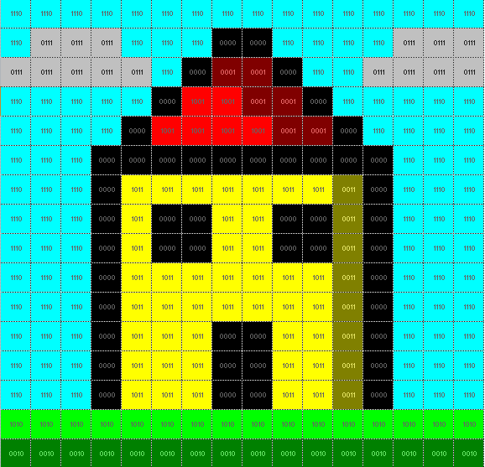

Some of my findings
Messages discovered hidden in beer barrels provided evidence towards the conviction of Mary Queen of Scots.
Nowadays steganography is mostly used by cybercriminals to hide malicious software.
Steganography has a large potential in watermarking to protect against illegal distribution.
LSB modification can be countered using a technique called steganalysis:

Slide 4

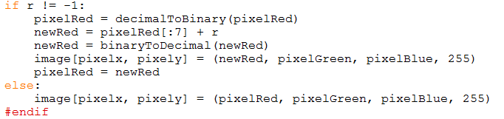
The Artefact

Slide 5
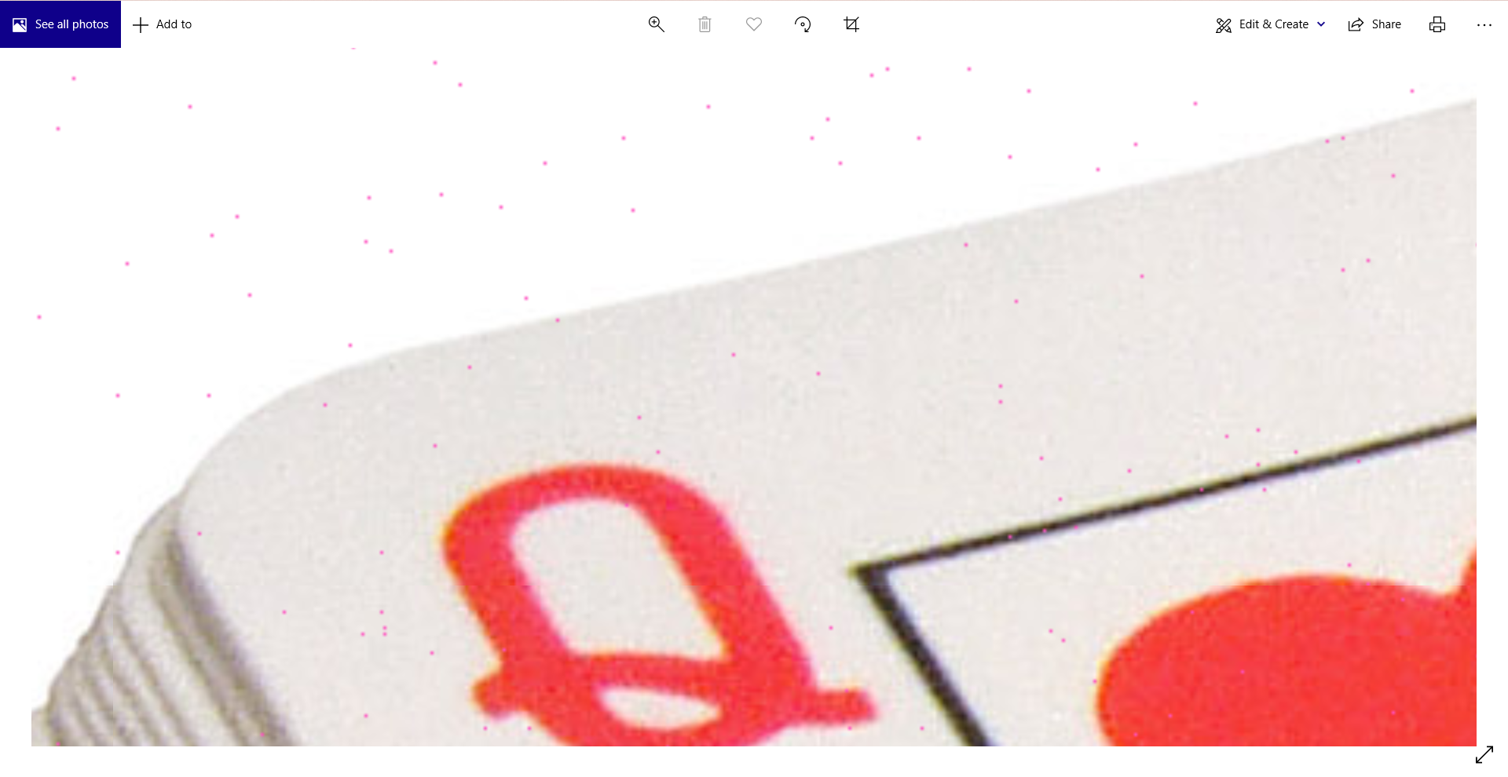
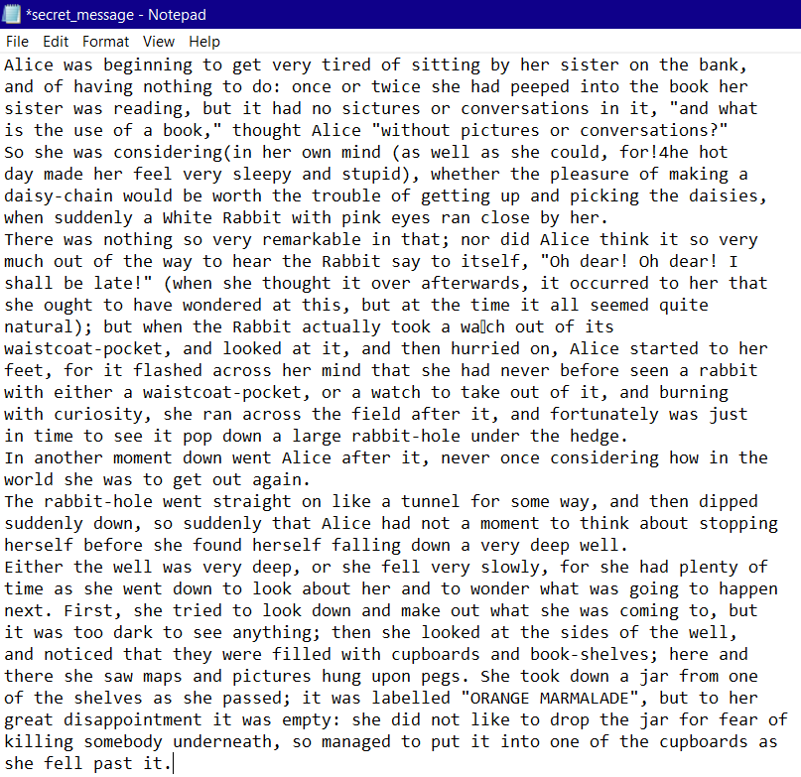

Slide 6
Evaluation
What I have gained:
Time management skills
Keeping concise but thorough notes
Practical insight into the application of steganography
What I would change:
Look for more reliable sources from reputable authors
Explore some already-existing steganography software

